Slide 1
To Online Shop or To Not Online Shop
SD May 20-19
Team Members: Amiah Gooding, Matthew Martin, Maxwell Minard, Travis Stanger, Smruthi Sandhanam, and Yana Aleksandrova
Client/Advisors: Goce Trajcevski

Slide 2
Outline
Introduction
Design Plan
Statement of Work
Timeline and Resources
Testing and Implementation
Future Plans
SD May 20-19
Notes:
5 minutes for each person

Slide 3
Introduction
SD May 20-19

Slide 4
Trends
Online Shopping:
E-Commerce growing 3 times faster than retail
Companies have made it easier to buy groceries online
Offering discounts on items and delivery
In 2019, 93 million online grocery purchasers
In-Store Shopping:
56% of shoppers would like to see and touch items before purchase
Marketing trend towards increasing in-store purchases using location aware advertising
Offer discount coupons based on user’s proximity of particular stores
SD May 20-19

Slide 5
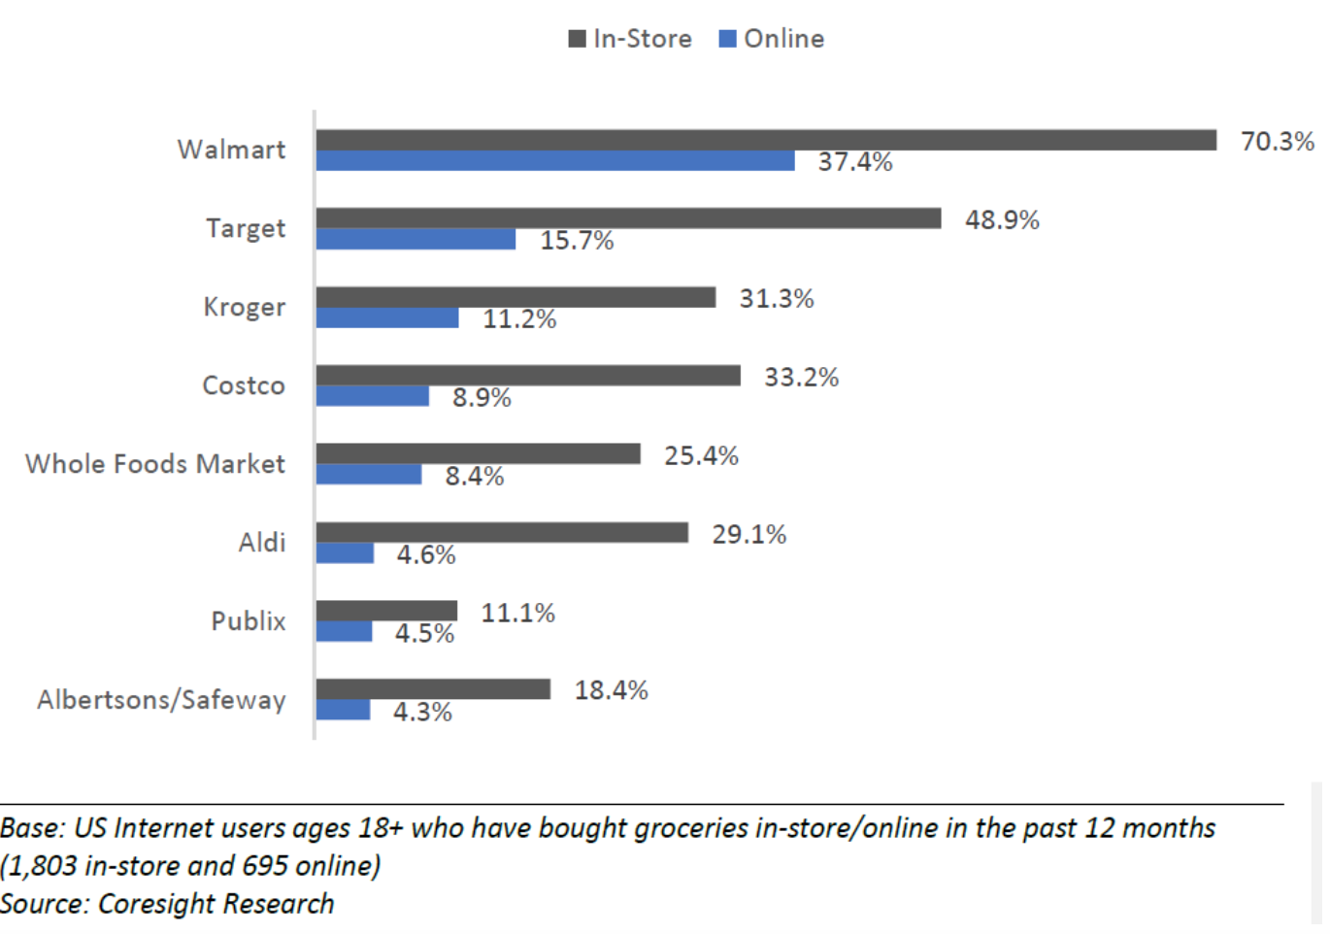
U.S. Online Grocery Survey (2019)
Figure 1: R. Redman, “Number of online grocery shoppers surges,” Supermarket
News (SN), May 2019.
SD May 20-19
Notes:
U.S. Online Grocery Survey

Slide 6
Goal
Design a solution that will help users find a balance between in-store and online shopping experiences
Develop an end-to-end IoT solution that will:
Monitor the status of items in a shelf or cabinet
Generate a list of items “to buy” and prepare an online order
Location-aware notification for users that certain items needed are available at a nearby store at acceptable prices
Automatic update of online orders if user decides to purchase items in store
SD May 20-19

Slide 7
Design Plan
SD May 20-19
Notes:
Yana

Slide 8
Design Plan
Non-Functional Requirements:
Availability: Available to update automatically every 12 hours
Data Integrity: Accurate & consistent data
Deployment: Pantry cupboard
Scalability: Modular designs
Resilience: Constant change
Usability: Intuitive, clear steps for setup and access
SD May 20-19

Slide 9
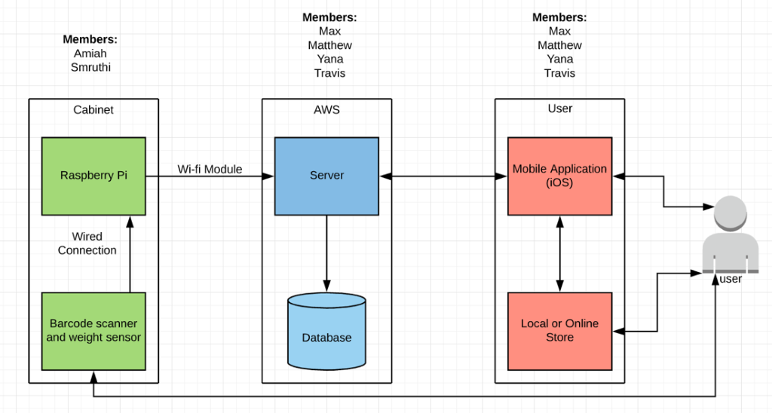
Design Plan
Proposed Design
SD May 20-19

Slide 10
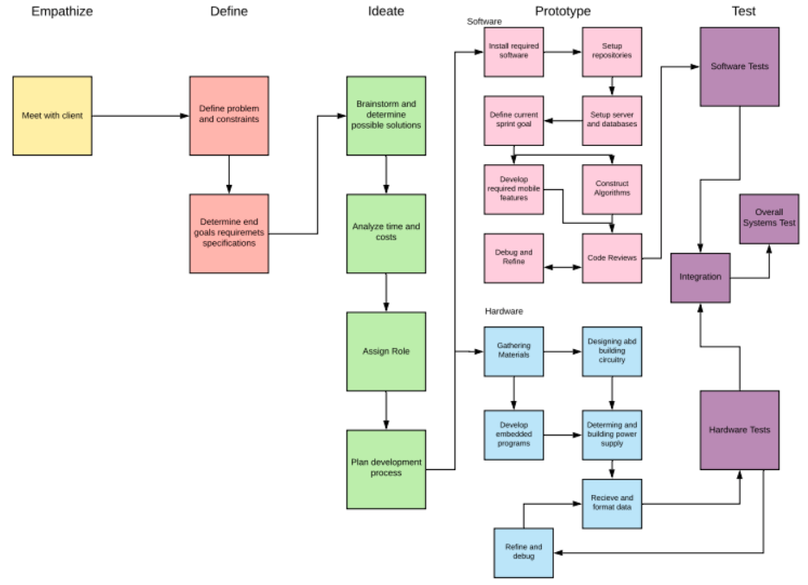
Design Plan
Design Plan:
SD May 20-19

Slide 11
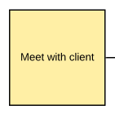
Design Plan
Design Plan: Empathize
SD May 20-19

Slide 12
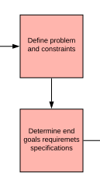
Design Plan
Design Plan: Define
SD May 20-19

Slide 13
Design Plan
Design Plan: Ideate
SD May 20-19

Slide 14
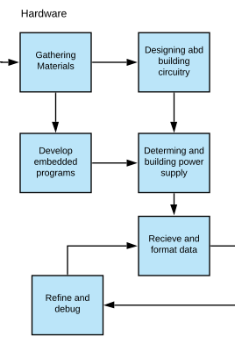
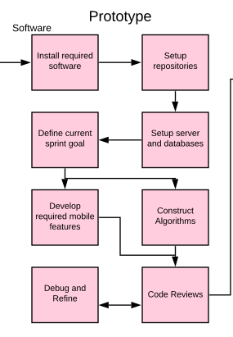
Design Plan
Design Plan: Prototype
SD May 20-19

Slide 15
Design Plan
Design Plan: Test
SD May 20-19

Slide 16
Statement of Work
SD May 20-19

Slide 17
Technical Considerations and Constraints
Choice of Sensors - RFID vs. Barcode Scanner
Database - Amazon Web Services
Master System - Arduino vs. Raspberry Pi
SD May 20-19

Slide 18
Possible Risks and Mitigation
Sensor Degradation - Sensors may not calibrated over time
Response - Calibrate the sensors on a regular basis
Communication - A connection with the application and the database updating timely
Response - Having strong time constraints on sending updated information to the database
Unfamiliarity - New Technology
Securing outside sources to compile information and placing in uniform location
SD May 20-19

Slide 19
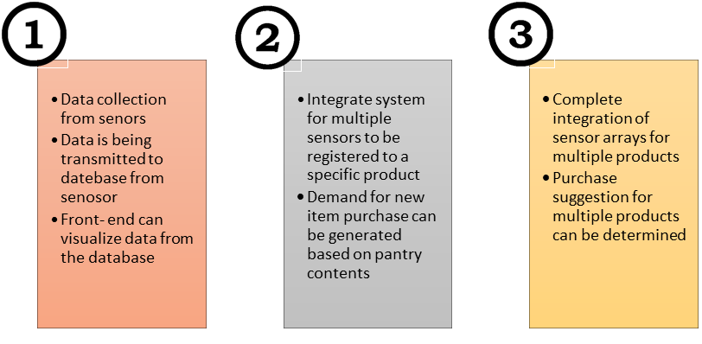
Phase Decomposition
Proof of Concept
Minimum Viable Product
Finalized Product
SD May 20-19

Slide 20
Timeline and Resources
SD May 20-19
Notes:
avoid redundancies: 11 & 29, use case diagram on slide 10, overlap and separate bar ⅚ with hardware and software and assign roles. Shade phase 2 initially. Generate design sketches.

Slide 21
Project
Timeline
SD May 20-19

Slide 22
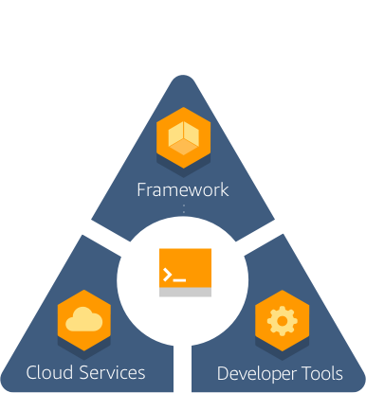
Feasibility Assessment
Expectation:
Proof of concept IoT solution
Target towards one spot in the home
Main Challenges:
New technologies (Ex: AWS)
Time Management
SD May 20-19

Slide 23
Personnel Effort Requirements
Set up AWS server and database (40+ hours)
Develop front-end user interface (100 hours)
Algorithms and data analysis (50 hours)
Construct circuits/hardware components (80 hours)
Embedded programming (80 hours)
Testing and Integration (150 hours)
SD May 20-19

Slide 24
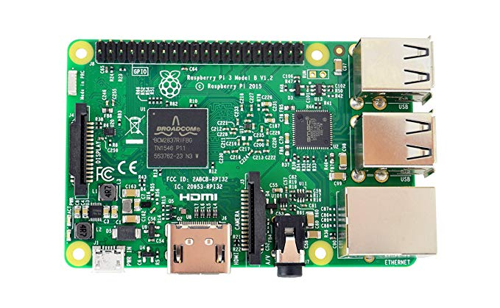
Resource Requirements
Raspberry Pi 3 Model B
Barcode scanner
Weight Sensor
Wires and circuit components
Power supply
AWS server and database
Makeshift cabinet and items for test simulation
SD May 20-19

Slide 25
Financial Requirements
Budget: Under $200
Material Costs:
Raspberry Pi: $35-$40
Weight Sensor: Potentially free?
Barcode Scanner: $50-$100
SD May 20-19

Slide 26
Testing and Implementation
SD May 20-19

Slide 27
Functional Test Plan
Hardware Testing
Manually verified connections
Python Scripts
Software Testing
XCTest: built-in unit testing with XCode
Manual scenarios
Integration Testing
SD May 20-19

Slide 28
Non-Functional Test Plan
Scalability: Progressively add users to database and ensure all have access.
Data Integrity: Send data from sensor to database and compare log files in both places.
Usability: Compare time to manually find a deal and the time for automatic alert to be sent.
SD May 20-19

Slide 29
Current Status
Raspberry Pi setup
Front-End screen sketches
Amplify framework setup
Database Initialization
SD May 20-19

Slide 30
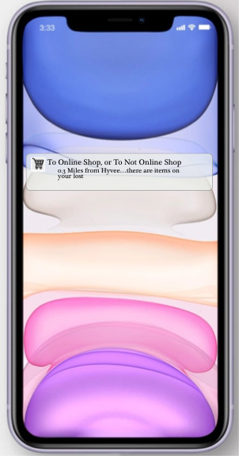
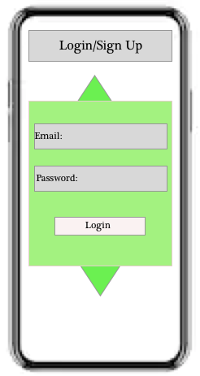
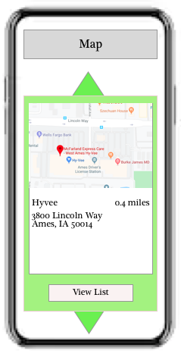
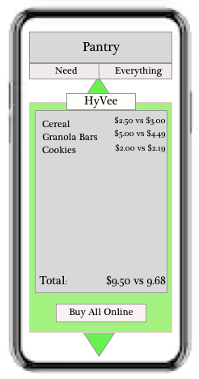
Current Status
SD May 20-19

Slide 31
Future Plans
SD May 20-19

Slide 32
Spring 2020
Revisit design decisions (January)
Define and start individual component testing (February)
Complete initial integration, define and start integration testing for plausible use cases (March)
Complete dry-runs of demo, finalize deliverable version (April)
SD May 20-19

Slide 33
Spring 2020: Gantt

Slide 34
Questions?
SD May 20-19

