Slide 1
To Online Shop, Or to Not Online Shop
By: Amiah Gooding, Matthew Martin, Max Minard, Smruthi Sandhanam,
Travis Stanger, and Yana Aleksandrova
Sdmay20-19

Slide 2
Overall Scope
Purpose: Utilize online shopping and at-home experiences to enhance the shopping capabilities of customers.
What is it?: An IOT based solution that combines mobile app development, communication with hardware sensors, and data management.
Expected Outcome: A proof of concept for a single location (ex: cabinet or cupboard) with hopes of expanding to other places in the home.

Slide 3
Technical Goals
Home IoT Goals
Sensor based data collection
Populating application database with the itemized pantry contents
Sensor data to be transmitted on Wi-Fi to Arduino
Application Goals
Mobile application that gathers data from hardware components via an itemized database
Application retrieves the list items need to be bought from the database
Algorithms to determine if it's cheaper to buy items online or in-store
Uses geolocation to figure out the best deal for buying a product

Slide 4
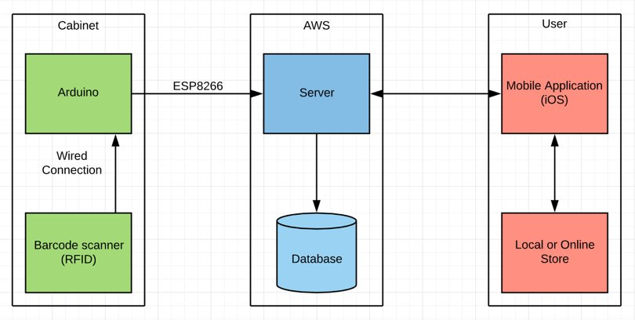
System Block Diagram

Slide 5
Timeline
Position | Milestone/Activity | Start Date | End Date
1 | Formalize Scope/Identify main components | 9/6/19 | 9/20/19
2 | Research | 10/1/19 | 10/10/19
3 | Use-case scenarios and main approaches | 10/7/19 | 11/1/19
4 | Converge on design/Basic functionality | 11/1/19 | 11/30/19
5 | Revisit design decisions | 1/13/20 | 1/30/20
6 | Begin Component Testing | 1/30/20 | 2/28/20
7 | Complete initial integration w/ testing | 2/28/20 | 3/30/20
8 | Complete "dry-runs" of demo | 3/30/20 | 4/30/20
Task # | Sep-19 | Oct-19 | Nov-19 | Dec-19 | Jan-20 | Feb-20 | Mar-20 | Apr-20
1 | X
2 |  | X
3 |  | X
4 |  |  | X
5 |  |  |  |  | X
6 |  |  |  |  |  | X
7 |  |  |  |  |  |  | X
8 |  |  |  |  |  |  |  | X

